Slide 1
Chapter 4
Hardware and Software
Notes:
This chapter discusses hardware, software, and open source alternatives, and defines basic terms and fundamental computing concepts. It briefly touches on new developments in self-driving cars, 3D printing, and the Internet of Things. Plus, t looks at the importance of Web applications and mobile systems.

Slide 2
“3D Printing Our Own Drones Isn’t Going to Save Us Enough Money.”
Investigating 3D-printing parts to make drones in-house.
Cost-savings, greater flexibility updating current fleet of drones.
Not enough drone parts can be replaced.
Passive recharging platform using 3D-printed parts a huge success.
Cutting edge frustrating, costly.
Notes:
GOALS
Show a realistic outcome for the team’s investigation: Falcon Security is not a manufacturer.
Demonstrate the innovative application of new 3D printing technology.
Chapter 3 discussed we talked about processes and systems Falcon would have to build if it started manufacturing its own drones. What were some of those processes and systems they would have to build?

Slide 3
Study Questions
Q1: What do business professionals need to know about computer hardware?
Q2: How can new hardware affect competitive strategies?
Q3: What do business professionals need to know about software?
Q4: Is open source software a viable alternative?
How does the knowledge in this chapter help you?
Notes:
You don’t need to be an expert. You don’t need to be a hardware engineer or a computer programmer. You do need to know enough, however, to be an effective
consumer. You need the knowledge and skills to ask important, relevant questions and understand the answers.

Slide 4
Q1: What Do Business Professionals Need to Know About Computer Hardware?
Central processing unit (CPU) - “the brain”
Dual-processor and Quad-processor computers
CPUs:
Vary in speed, function, cost
Work in conjunction with main memory (RAM)
Read data and instructions from memory, stores results of in RAM
Notes:
Computer hardware consists of electronic components and related gadgetry that input, process, output, and store data according to instructions encoded in computer programs or software. All hardware today basically has the same components.

Slide 5
Storage Hardware
Save data and programs
Common storage devices
Non-volatile
Magnetic disks (Hard drive)
Solid-state storage (SSD)
Thumb drives
Optical disks (CD/DVD)
Volatile
Cache and main memory

Slide 6
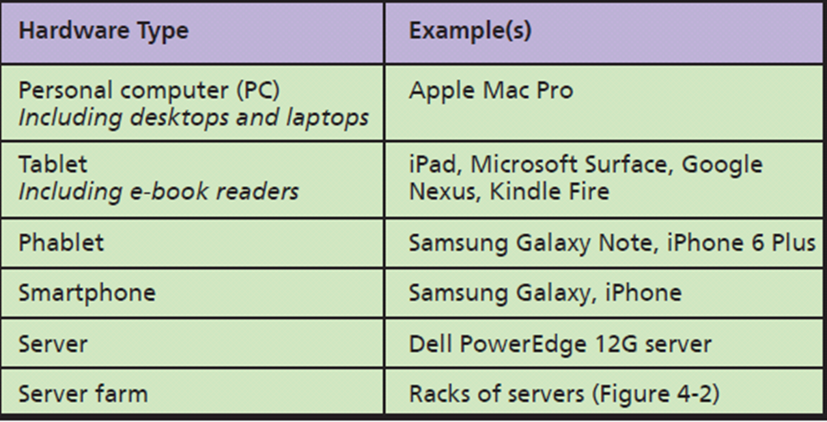
Basic Types of Hardware
Notes:
PCs are being supplanted by tablets and other mobile devices.
Phablet combines the functionality of a smartphone with the larger screen of a tablet.

Slide 7
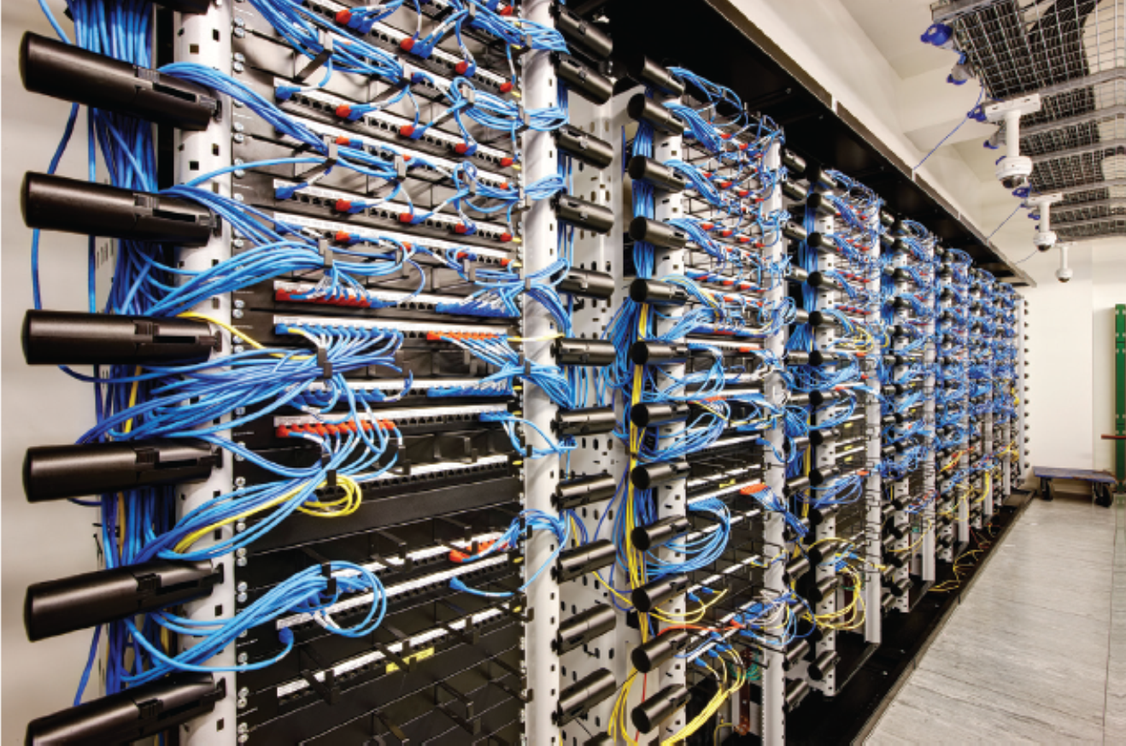
Server farm
Server farms often placed in large truck trailers holding 5,000 servers or more
Notes:
A server is a computer that is designed to support processing requests from many remote.

Slide 8
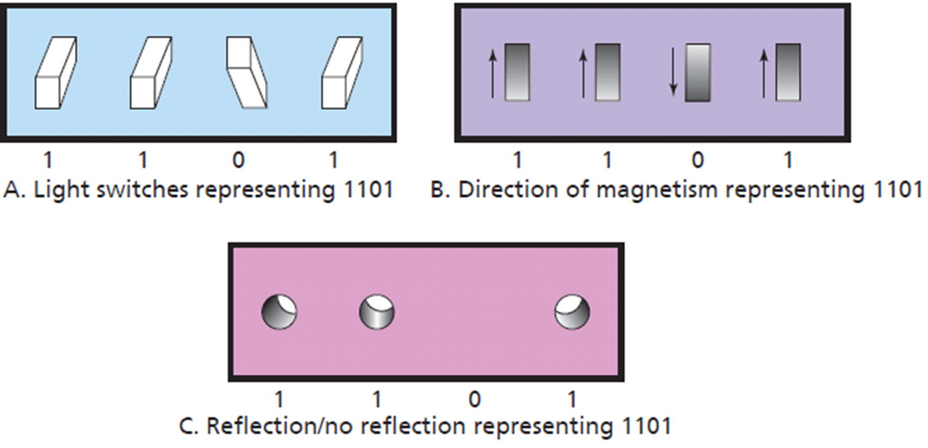
Computer Data: Binary Digits (Bits)
Magnetic spot
Reflective pit
Notes:
Bits are used for computer data because they are easy to represent electronically.
Bits are used to represent electronically. A switch can be open or closed.
An open switch represents 0 or “off” and a closed switch represents “1” or “on”.

Slide 9
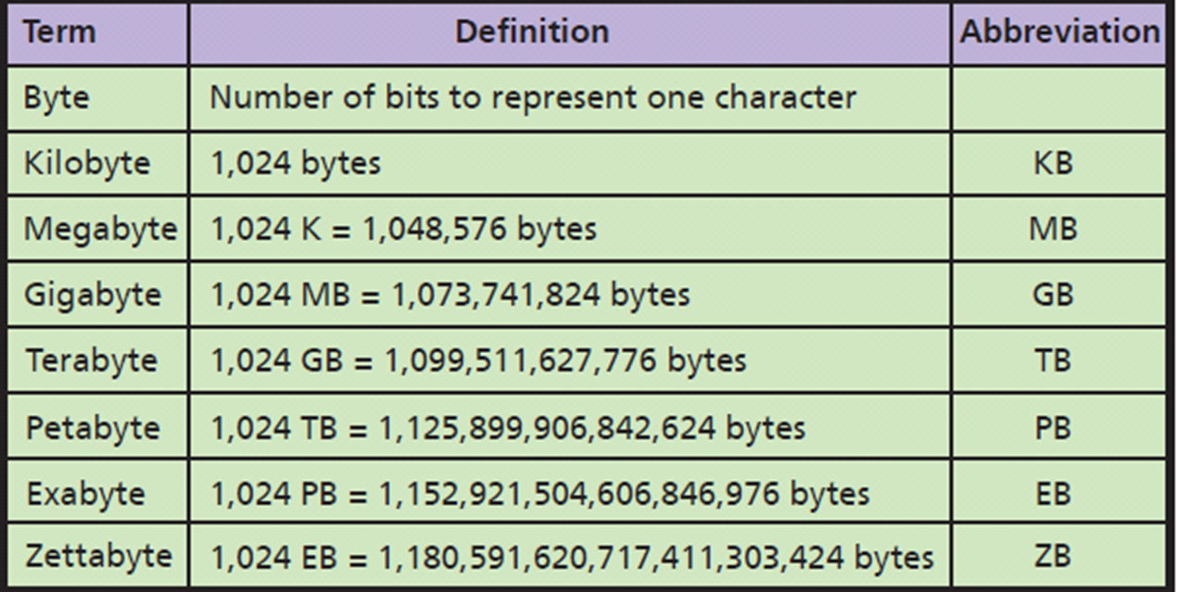
Important Storage Capacity Terminology
Walmart 2.5 PB of customer data.
Notes:
All computer data represented by bits. Data can be numbers, characters, currency amounts, photos, recordings, or whatever. All are simply a string of bits. Specifications for size of main memory, disk, and other computer devices are expressed in bytes.

Slide 10
Specifying Hardware with Computer Data Sizes
Computer disk capacities by bytes of data storage
500 GB
CPU speed in cycles called hertz
Slow personal computer speed of 3.0 Gigahertz
Fast PC 3.5+ GHz
12 GB+ RAM for large applications

Slide 11
Q2: How Can New Hardware Affect Competitive Strategies?
Smart device
Processing power, large memory, Internet access, Wi-Fi connectivity, ability to interconnect with other devices and applications
Potential to disrupt existing organizations
Internet of Things (IoT)
Self-driving vehicles
3D Printing
Notes:
Organizations are interested in new hardware because they represent potential opportunities, or threats, to their ability to generate revenue.

Slide 12
Internet of Things (IoT)
Everyday objects embedded with hardware capable of sensing, processing, transmitting data
Connect to a network to share data with any other applications, services, devices
Notes:
Evolution of the smart phone and devices.

Slide 13
Impact of the Internet of Things
GE’s Industrial Internet
Increase efficiencies, reduce waste, improve decision making
Greatest potential for smart devices in hospitals, power grids, railroads, and manufacturing plants
Smart buildings (Microsoft)
ID wasteful lighting, heating and cooling systems, and rogue fans

Slide 14
Self-driving Cars by 2019
Make life easier, cheaper, safer
Reduce human error
Fewer automobile accidents
Avoid costly traffic tickets, parking tickets, DUI citations
Eliminate need for multiple cars
Notes:
Also, self-driving trucks (http://www.wired.com/2015/05/worlds-first-self-driving-semi-truck-hits-road/), farm equipment (https://www.youtube.com/watch?v=D7xc45LyhoU), etc.

Slide 15
Self-driving Cars Will Disrupt Businesses
Auto sales
Fewer cars on road may mean fewer cars sold
Auto loans, insurance, car repair
More jobs for engineers, programmers, systems designers
More computer hardware, sensors, and cameras in vehicles
Notes:
How will self-driving cars disrupt your personal life? Eliminate pizza delivery jobs?

Slide 16
3D Printing
Plastics, metals, ceramics, foods, biological material
Opportunities in aerospace, defense, automotive, entertainment, healthcare industries
What happens when 3D-print extra-large objects like cars, planes, boats, houses, and drones happens?

Slide 17
Existing 3D Printing Examples
ChefJet, culinary artists and novices can produce intricate, beautiful, and fully customized deserts
Living cells (organs, bones, heart valves, skin)
Houses, buildings

Slide 18
So What? New from CES 2015
Driverless Mercedes-Benz F 015
“Works with Nest” – home automation and IoT convergence.
MakerBot
3D printing in metal, wood, and stone
Print 50+% of typical household items
Notes:
Have students brainstorm:
What would be the benefits of Mercedes-Benz’s new “carriage”-type driverless car over a traditional car converted to be driverless?
Why would Mercedes-Benz want its new driverless cars to talk to pedestrians?
How could a Nest thermostat save you money?
What household objects would they print? Why?
What impact could filaments affect innovation, prototyping, and new product development

Slide 19
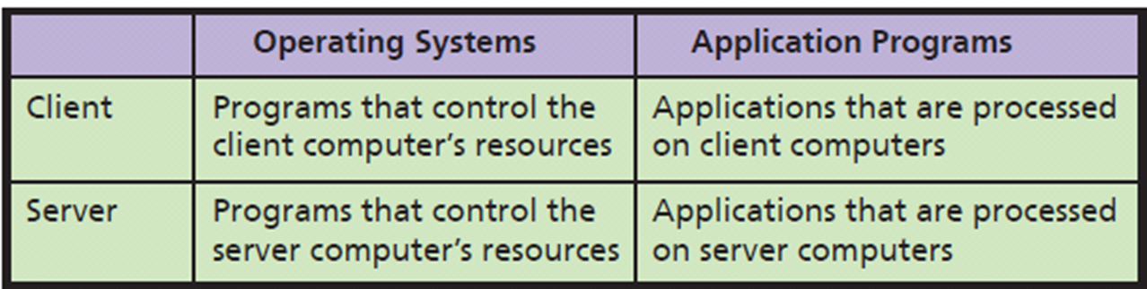
Q3: What Do Business Professionals Need to Know About Software?
Native applications
Thin-client vs thick-client applications
Web applications
Notes:
You need to know about functions of operating systems, servers, and applications. What are your choices? Which to choose?

Slide 20
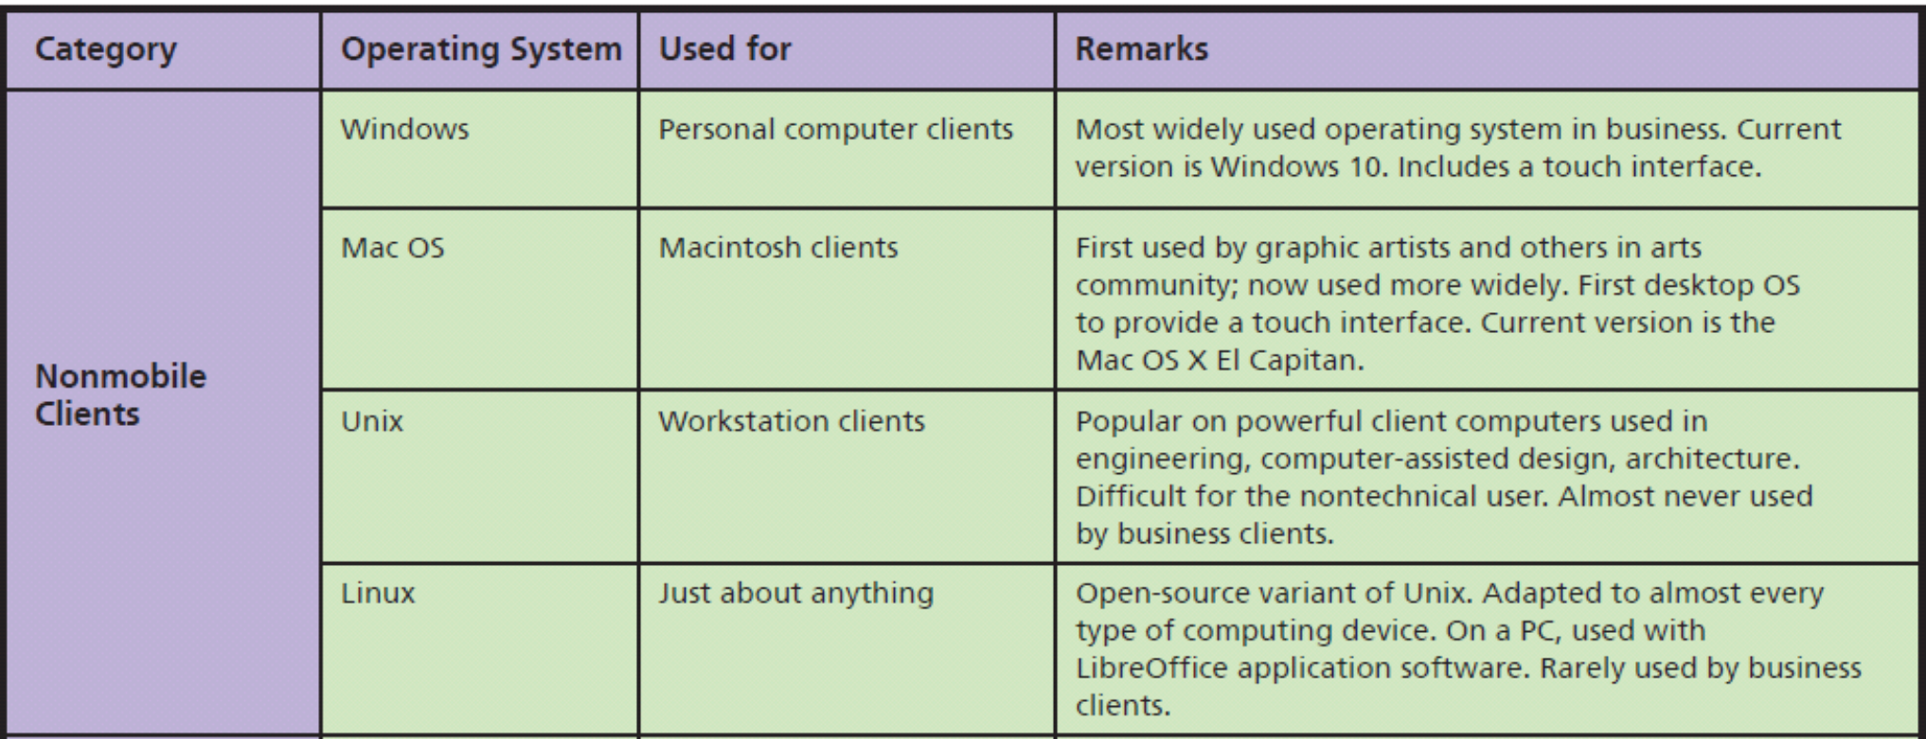
Major Operating Systems
Notes:
Some version of Windows resides on more than 85 percent of world’s desktops, and, for business users, it's more than 95%.
Macintosh with an Intel processor is able to run both Windows and the Mac OS.

Slide 21
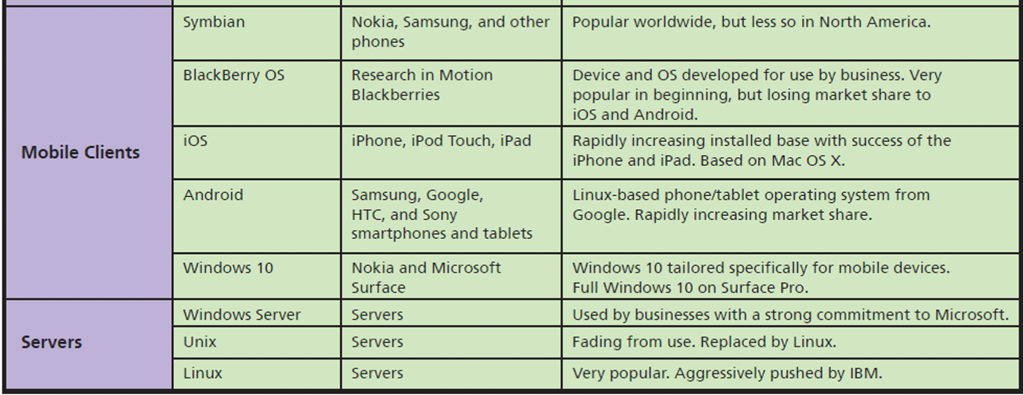
Major Operating Systems (cont'd)

Slide 22
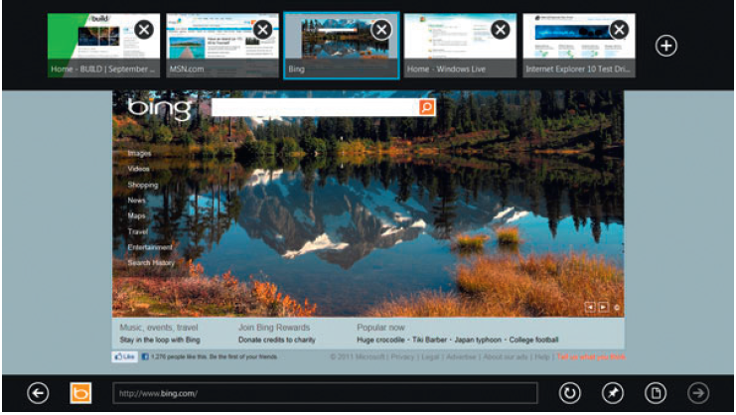
Example of the Modern Style Interface
Notes:
Windows 8 is distinguished by what modern-style applications that are touch-screen oriented and provide context-sensitive, pop-up menus used with a mouse and keyboard.

Slide 23
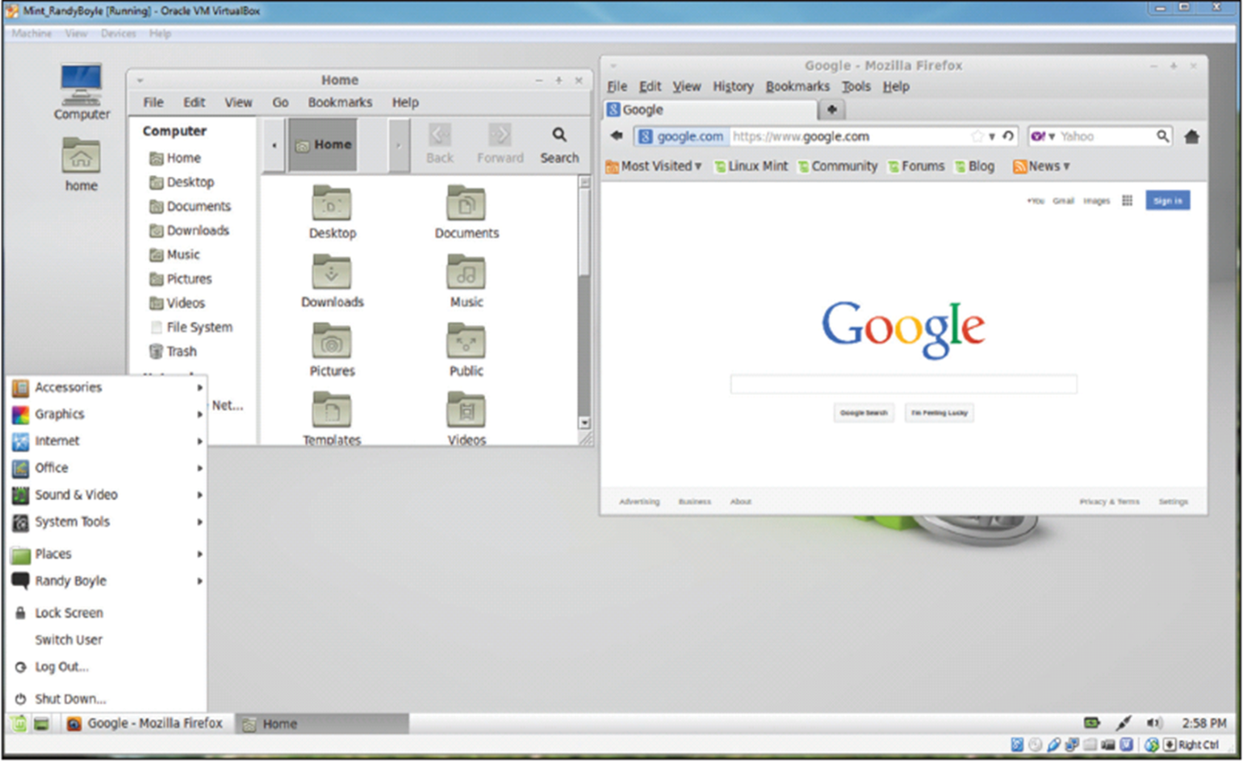
Linux Mint Virtual Machine Running in Microsoft Windows 7 Professional
• PC virtualization
• Server virtualization
• Desktop virtualization

Slide 24
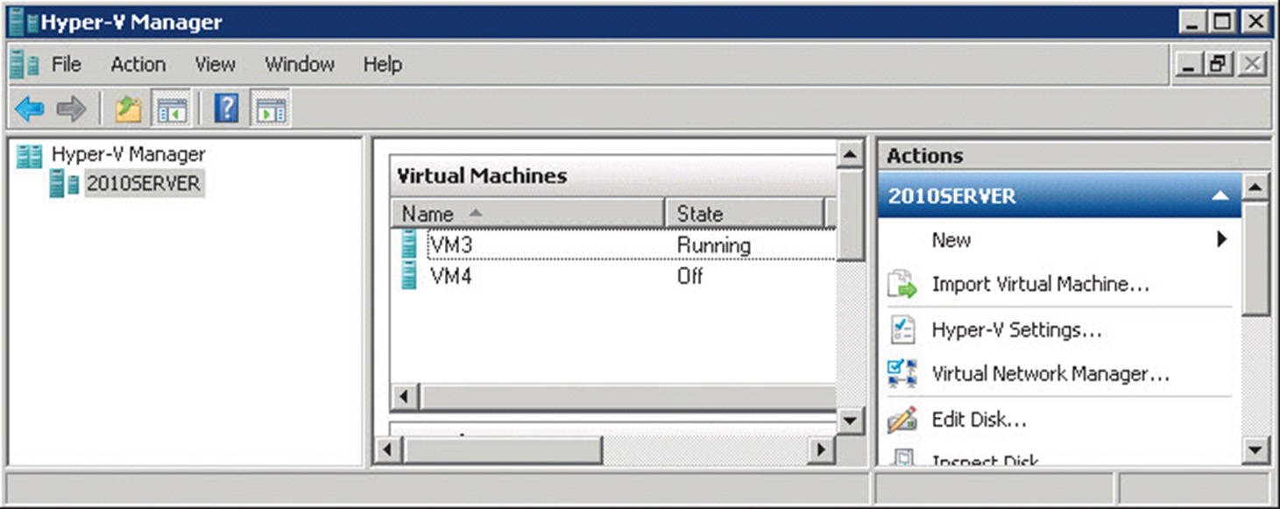
Windows Server Computer Hosting Two Virtual Machines
Notes:
Virtualization: process by which one computer hosts the appearance of many computers. One operating system, called the host operating system runs one or more operating systems as applications. Hosted operating systems are called virtual machines (vm).
Each virtual machine has disk space and other resources allocated to it. Operates as if installed on own computer.
Host operating system controls activities of virtual machines to prevent them from interfering with one another.

Slide 25
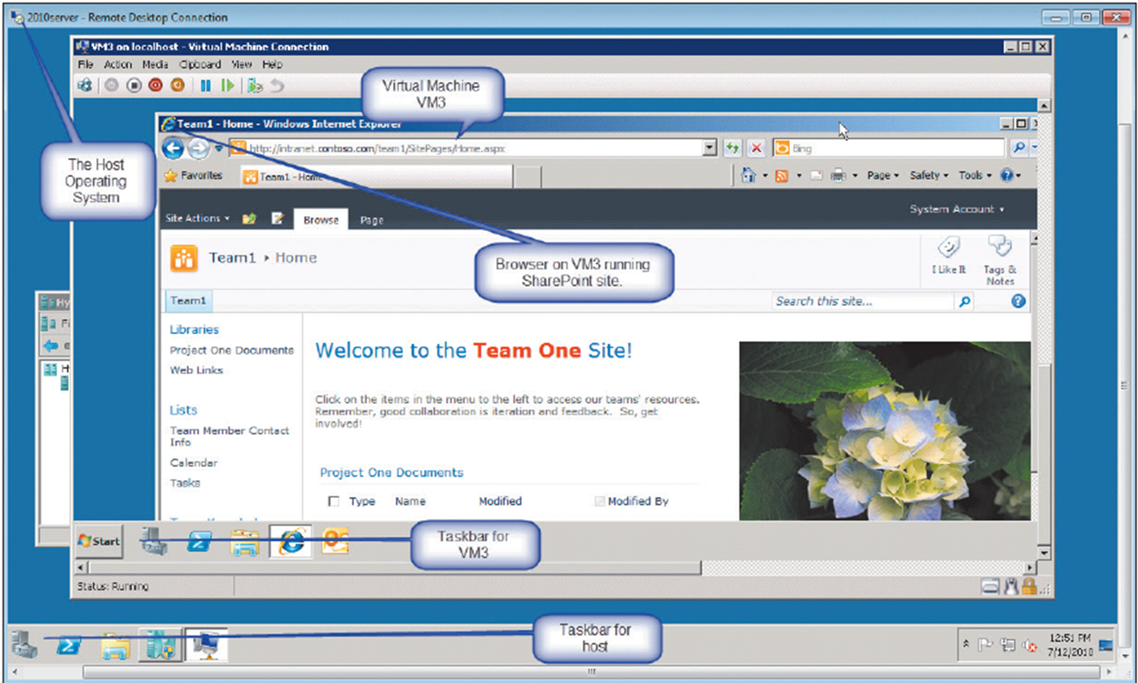
How Virtual Machine Example
Notes:
User of VM3 is running a browser accessing SharePoint.

Slide 26
Owning Versus Licensing
License
Right to use specified number of copies
Limits vendor’s liability
Site License
Flat fee to install software on all company computers or all computers at specific site
Open Source
No license fee
Notes:
You do not actually own a program—you own a license or right to use the program.
When you buy a Windows license, Microsoft is selling you the right to use Windows. Microsoft continues to own the Windows program.
Large organizations negotiate a site license that authorizes the company to install the product on all company computers or a specific site.
Linux, no company can sell you a license to use it. It is owned by the Open Source Community.

Slide 27
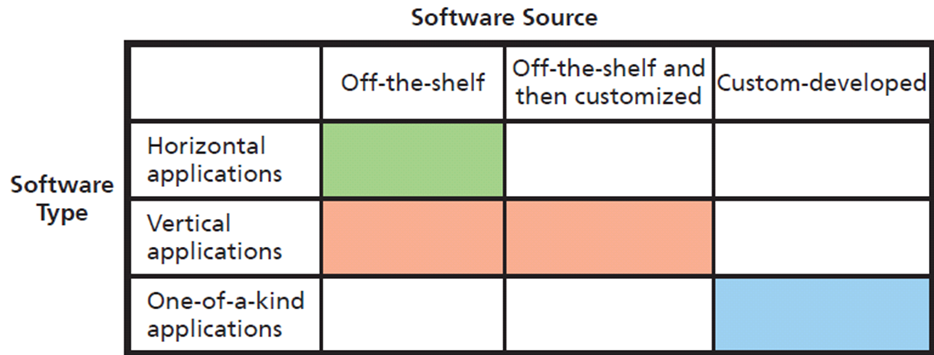
What Types of Applications Exist, and How Do Organizations Obtain Them?
Notes:
Application software performs a service or function. Some application programs are general purpose, such as Microsoft Excel or Word. Other application programs provide specific functions.

Slide 28
What Is Firmware?
Special software on read-only memory (ROM)
Printers, print servers, communication devices
As if program’s logic designed into device’s circuitry
Changeable and upgradable, usually IS professionals

Slide 29
Q4: Is Open Source Software a Viable Alternative?
• LibreOffice (the default office suite in Linux distributions)
• Firefox (a browser)
• MySQL (a DBMS, see Chapter 5)
• Apache (a Web server, see Chapter 6)
• Ubuntu (a Windows-like desktop operating system)
• Android (a mobile-device operating system, described earlier)
• Cassandra (a NoSQL DBMS, see Chapter 5)
• Hadoop (a BigData processing system, see Chapter 9)
Notes:
These are examples of successful open-source projects.

Slide 30
Why Do Programmers Volunteer Their Services to Open Source Projects?
Exercise creativity on interesting & fulfilling projects
Freedom to choose projects
Exhibit one’s skill to get a job
Start a business selling services
Succeeds because of collaboration
Notes:
Programming is an intense combination of art and logic. Designing and writing a complicated computer program is exceedingly pleasurable (and addictive).
Programmers can exercise creativity while working on projects they find interesting and fulfilling.
Programmers can exhibit their skill, both for pride, finding a job or consulting employment, or start a business selling services to support an open source product.

Slide 31
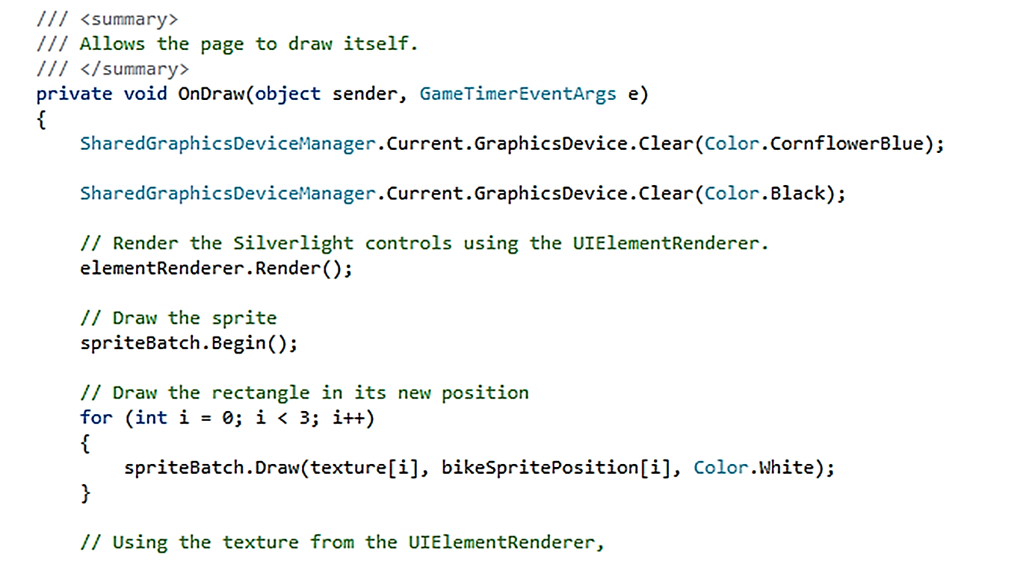
Source Code Sample

Slide 32
How Does Open Source Work?
Machine code: Source code compiled into instructions executed directly by computer’s CPU
Closed-source or proprietary software Only available to trusted employees and carefully vetted contractors
Open-source software available to public
Source code: Human readable computer code
Software
Notes:
Collaboration of many programmers
Examining source code and identifying a need, creates new feature or redesigns existing feature, or fix a problem
Code evaluated and extended by others
Iteration, peer reviews and well-managed project yield high-quality code

Slide 33
So, Is Open Source Viable?
Depends on requirements and constraints
“Free” open source software might require support and operational costs exceed cost of licensing fee
Future a blend of both proprietary and open source software
Closed source project
Source code highly protected, only available to trusted employees and carefully vetted contractors
Notes:
Depends on requirements and constraints of situation. You will learn more about matching requirements and programs in Chapter 10.

Slide 34
Ethics Guide: Free Apps for Data
How do you monetize free apps?
“If you’re not paying for it, you are the product.”
Data Brokers
Snoopwall reports
Flashlight Apps
Require permission to access data about your location, network connectivity, USB storage, install shortcuts, receive data to/from the Internet, modify your system settings, and disable your screen lock
Notes:
Goals
Sensitize students to their security exposure.
Ask the class these questions.
Why would your flashlight need your GPS coordinates? Who was getting this data? What were they using it for? It looks like someone had already thought of your data-harvesting idea.
Apply Kant’s categorical imperative and utilitarian perspectives to work Google should do about flashlight apps available on Google.

Slide 35
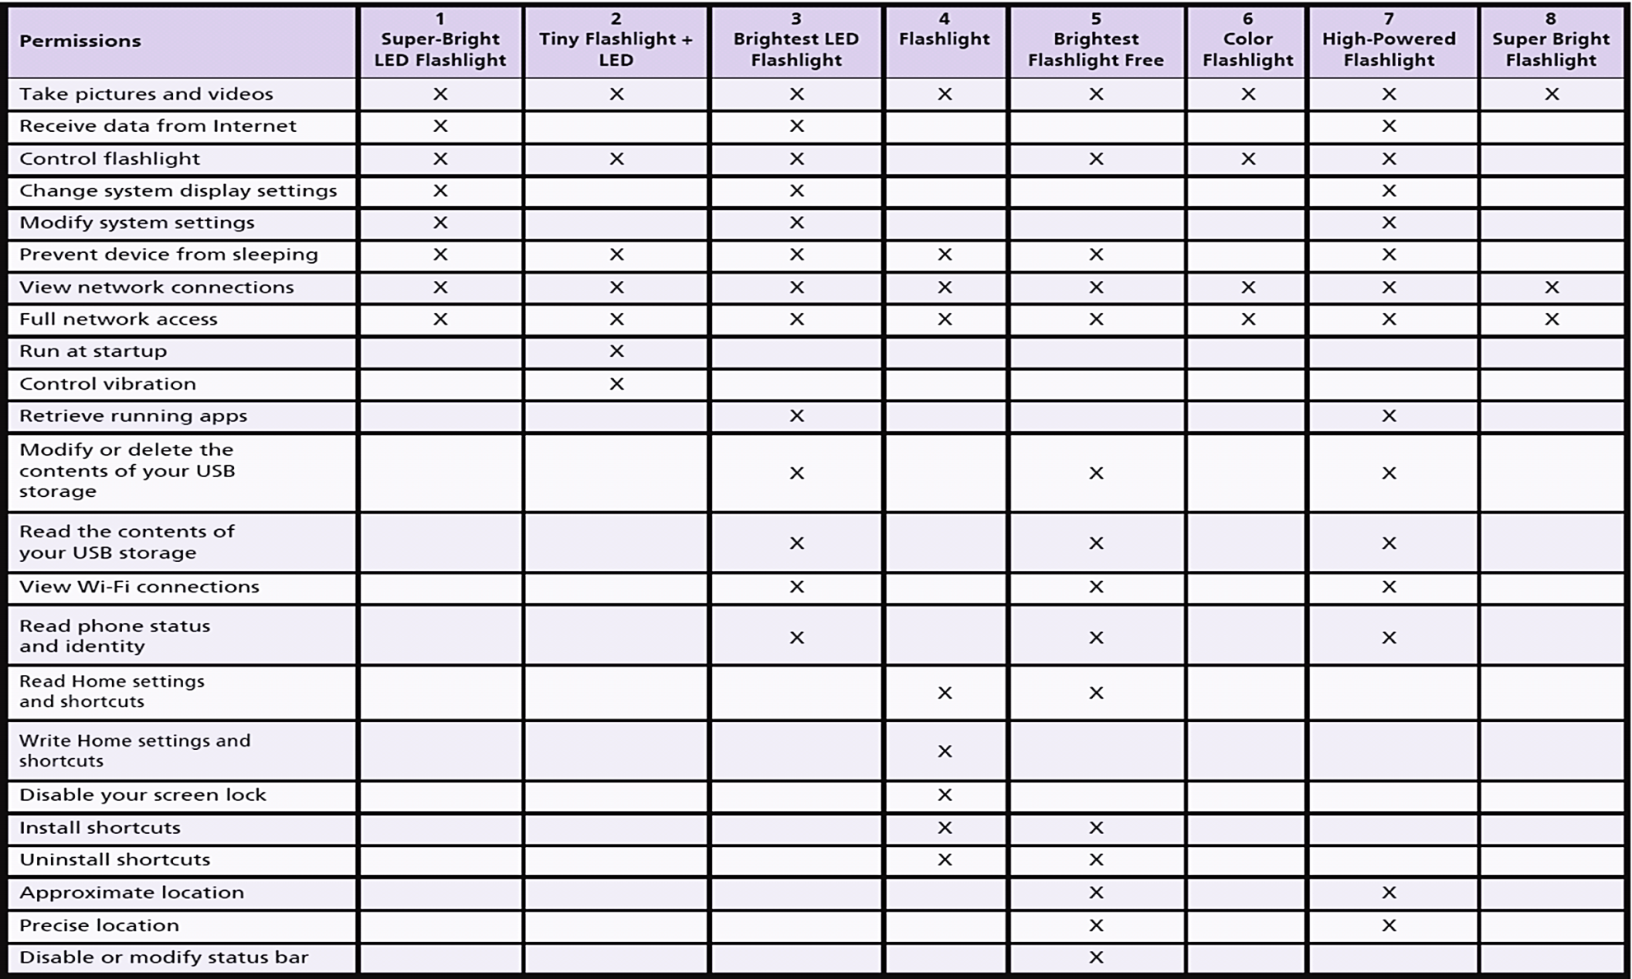
SnoopWall report
Notes:
The results are shown in the table, the bottom two rows show the changes in the number of permissions from 2013 to 2014.

Slide 36
Guide: Keeping Up to Speed
Relentless pace of change in technology
21st century business professional cannot bury head in sand
Use knowledge of IT to gain competitive advantage
Don’t ignore technology
Read articles, technology ads, attend seminars and workshops
Get involved as a user representative in technology committees
Notes:
GOALS
Raise students’ awareness of unrelenting change of technology.
Encourage students to take a stand about how they will react to technological change.
Emphasize this issue is inescapable in business. If students ignore it, they are choosing a personal competitive disadvantage.
Teach the students the benefits of this class and of IS education.

Slide 37
How Does the Knowledge In This Chapter Help You?
Understand your involvement with technology in commerce
You learned about hardware and software
Gained knowledge of application software sources
Learned about open source software and why not always viable option
Learned hardware/software knowledge is perishable

Slide 38
Active Review
Q1: What do business professionals need to know about computer hardware?
Q2: How can new hardware affect competitive strategies?
Q3: What do business professionals need to know about software?
Q4: Is open source software a viable alternative?
How does the knowledge in this chapter help you?

Slide 39
Case Study 4: PSA Cruising with Information System
Port of Singapore is the world’s second busiest in terms of total shipping tonnage
Large protected harbor
Strategically positioned on major trade routes
Skilled manpower
Port of Singapore Authority (PSA) manages harbor facilities
These strengths coupled with an unmatched value proposition provided by information systems account for the port’s success

Slide 40
Case Study 4: PSA Cruising with Information System (cont’d)
The success of the port depends on the effective management of containers
Computer Integrated Terminal Operation System (CITOS) addresses this issue
Allocates appropriate berth to a ship on arrival
Decides on the number of cranes required to unload containers
Ship planning sub-system

